Slide 1
Cyber security
Unit II
By
K Raja sekhar

Slide 2
contensts
Social engineering
Cyber stalking
Cyber cafe and cyber crimes
Botnets :the fuel of cyber crimes
Attack vector cloud computing
How do cyber criminals plan attacks

Slide 3
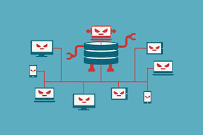
botnet

Slide 4
Botnets
the name itself is a blending of the words “robot” and “network”.
In a broad sense, that’s exactly what botnets are: a network of robots used to commit cyber crime. The cyber criminals controlling them are called botmasters or bot herders.
To build a botnet, botmasters need as many infected online devices or “bots” under their command as possible. The more bots connected, the bigger the botnet. The bigger the botnet, the bigger the impact. So size matters. The criminal’s ultimate goal is often financial gain, malware propagation, or just general disruption of the internet.

Slide 5
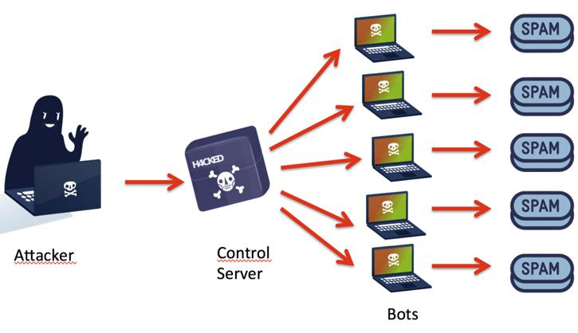
Working of botnets

Slide 6
Botnet infections
Control software's are injected or propagated through Trojan horses
Theses malwares will be under the control of bot header which makes its ‘bot’.
This malwares is used to
Track data
Change files
Opening gates for other viruses
DOS and DDOS attacks etc..

Slide 7
Other botnet attacks
Aside from DDoS attacks, botmasters also employ botnets for other malicious purposes
Ad Fraud
Cybercriminals can use the combined processing power of botnets to run fraudulent schemes. For example, botmasters build ad fraud schemes by commanding thousands of infected devices to visit fraudulent websites and “click” on ads placed there. For every click, the hacker then gets a percentage of the advertising fees.
Selling and Renting Botnets
Botnets can even be sold or rented on the internet. After infecting and wrangling thousands of devices, botmasters look for other cybercriminals interested in using them to propagate malware. Botnet buyers then carry out cyber attacks, spread ransomware, or steal personal information.

Slide 8


Botnet structures
Client server model
Peer to peer model

Slide 10
Botnet Prevention
Update your operating system
Avoid downloads from P2P and file sharing networks
Don’t click on suspicious links
Get Antivirus Software

